Slide 1
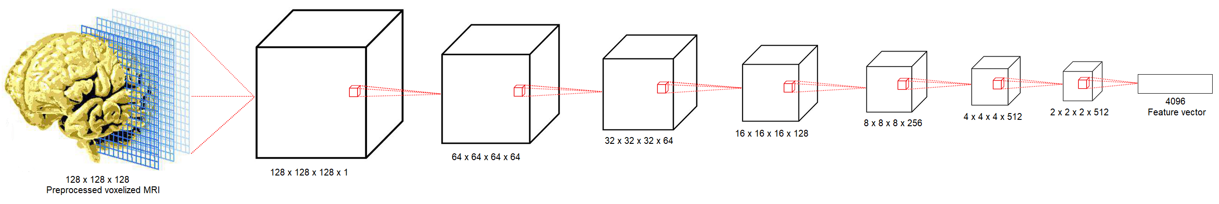
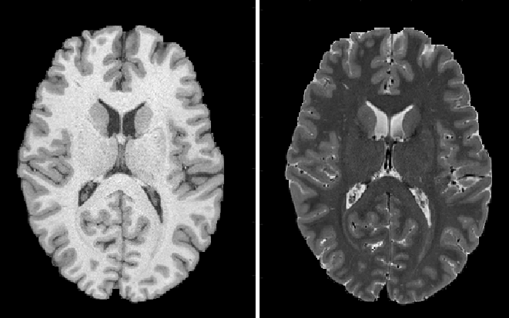
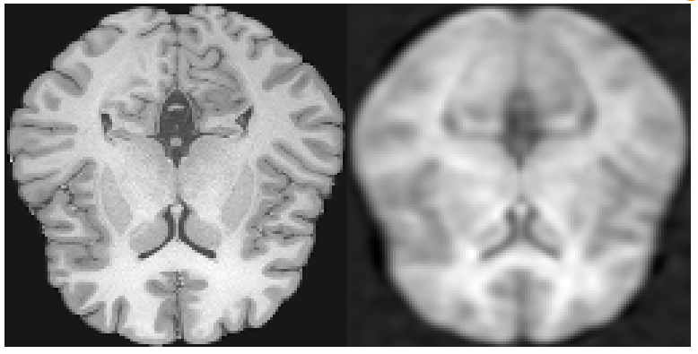
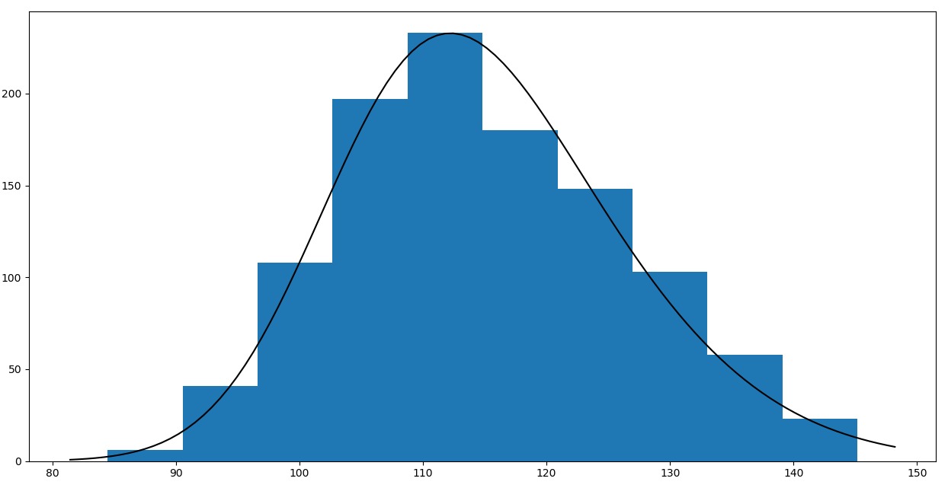
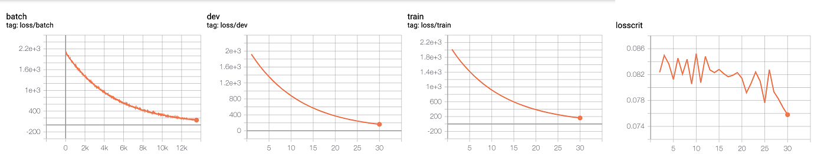
Predicting Fluid Intelligence from T1-weighted MRI Images
CSE 547:
Machine Learning for Big Data
Lynda Brady¹, Cody Cooper¹, Ryan Rowe²
¹UW Mechanical Engineering, ²UW Computer Science & Engineering
Motivation
Feature Extraction
Intelligence can predict conventional measures of success such as education, socioeconomic prosperity, health, and longevity. Correlation between IQ test performance and a single common general intelligence factor ___. This general intelligence factor consists of fluid intelligence (problem solving, quick thinking and acting, encoding new episodic memories, adaptation to novel situations) and crystallized intelligence (previously-learned “static” knowledge). Brain anatomy and physiology lends insight into the process of aging, ways to maintain fluid intelligence, and cognitive decline. Magnetic Resonance Imaging (MRI) non-invasively images tissues in the body. We hypothesize that the structure of the brain affects cognitive function and we seek to predict fluid intelligence using three-dimensional brain structure from MRI.
L₂ loss preserves general mathematical similarity
L₂ regularization discourages overfitting
Total Variation loss minimizes noise and gradient boundaries
Sobel loss retains cortical folds on brain volume outer edges
Preprocessing crops, resizes, and standardizes each 256 x 256 x 256 to 128 x 128 x 128 MRI
Data
Autoencoder extracts 4096 features from each 128 x 128 x 128 MRI
Human Connectome Project HCP 1200 dataset
Behavioral data for 1206 subjects
3T MRI brain imaging data for 1113 subjects, with additional 7T MRI data for selected subjects (n=184)
Subjects aged 22 to 35 years
Total data size of 80 TB
TODO: series of images that show autoencoder progression and feature preservation
Prediction Models
Results
Support Vector Machine
Distribution of intelligence scores - placeholder chart
Recommender System
Sources
[1]
Future Work
Acknowledgements
Thank you to Professor Tim Althoff and TA Swati Padmanabhan for project guidance, and to the Human Connectome Project for hosting a freely accessible database.

